Slide 1

Ethics and International Business
Chapter 5

Slide 2
Ethics in International Business
Ethics, CSR, Sustainability affect all societies and companies. In international business these issues become more complex:
Societal Norms
Level of social and economic development
Differences in Laws, Regulations
Differences in Business practices

Slide 3

Definition
Ethics – refers to accepted principles of right or wrong that govern the conduct of a person, the members of a profession, or the actions of an organization.

Slide 4
Major Issues
Human Rights
Employment Issues
Environmental Impacts
Corruption

Slide 5
Corruption
Foreign Corrupt Practices Act
https://www.justice.gov/criminal-fraud/foreign-corrupt-practices-act
Facilitation Payments
Corruption Index
www.transparency.de
OECD – Anti-bribery convention
https://www.oecd.org/corruption-integrity/

Slide 6
Ethical Dilemmas
Ethical dilemma – situations in which none of the available alternatives seems ethically acceptable.
Every situation involves trade-offs
Consider the 12-year-old girl who worked by cleaning the factory floor. The multinational requires her to be replaced by an Adult. But the 12 yr. old was an orphan and her job provided income to her and her 6 yr. old brother. After being let go, the girl becomes desperate…. Read the story in the text.

Slide 7
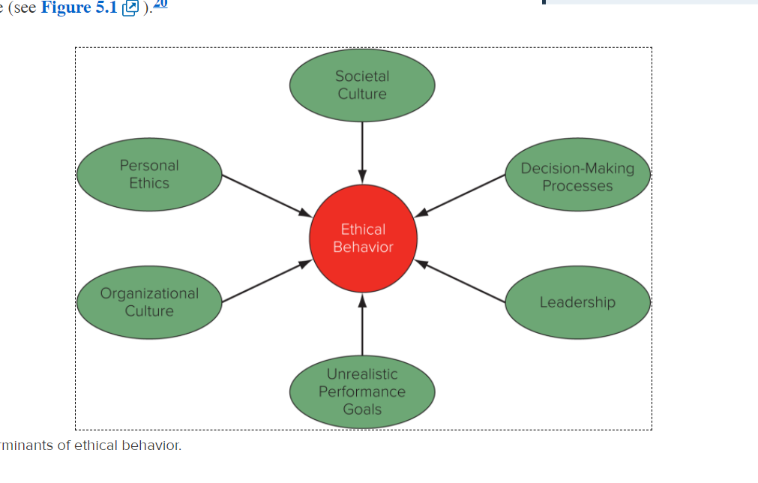
Determinants of Ethical Behavior

Slide 8
Philosophical Approaches to Ethical Behavior
Straw Men
Freidman Doctrine – business’ job is to create profit for shareholders within the rules of the game
Cultural Relativism – determined from culture
Righteous Moralist – or Ethnocentric – applying one’s own ethics (home country) – to all situations
Naïve Immoralist – “honor amongst thieves” – if the unethical behavior is acceptable in that country, then take advantage and do the same

Slide 9
Philosophical Approaches to Ethical Behavior
Utilitarian and Kantian Ethics
Utilitarian (Hume, Mill and Bentham) – actions are judged desirable if it leads to the best possible balance of good consequences over bad consequences (cost-benefit analysis).
Kantian Ethics – holds that people should be treated as an end in and of themselves, not as a means to an end.

Slide 10
Rights Theories
Universal declaration of Human Rights
Right to work, free choice for employment and favorable conditions
Without discrimination, the right to equal pay for equal work
Favorable renumeration
Free to join unions
Just Distribution (Rawls)
All economic goods and services should be distributed equally, except when an unequal distribution would work to everyone’s advantage

